Slide 1
Database systems
Amit Dua
Transactions

Slide 2
Agenda
Transactions
ACID Properties
Read and Write operations
Storage structure
Schedules
Concurrency and serializability
Concurrency control policy
Locks
Timestamps
Snapshot isolation˛

Slide 3
Transaction
Collections of operations that form a single logical unit of work are called transactions.
avoids the introduction of inconsistency

Slide 4
Atomicity
Since a transaction is indivisible, it either executes in its entirety or not at all.
“all-or-none” property is referred to as atomicity.
E.g. Money withdrawal from ATM

Slide 5
the database system must take special actions to ensure that transactions operate properly without interference from concurrently executing database statements. –isolation
a transaction’s actions must persist across crashes. This property is referred to as durability.

Slide 6
consistency.
This consistency requirement goes beyond the data-integrity constraints we have seen earlier (such as primary-key constraints, referential integrity, check constraints, and the like).
application-dependent consistency constraints

Slide 7
ACID properties
What does it mean by following ACID properties while Shopping at Amazon?

Slide 8
Read and Write
read(X), which transfers the data item X from the database to a variable, also called X, in a buffer in main memory belonging to the transaction that executed the read operation.
write(X), which transfers the value in the variable X in the main-memory buffer of the transaction that executed the write to the data item X in the database.

Slide 9
Ti:
read(A);
A := A − 50;
write(A);
read(B);
B := B + 50;
write(B).
How do you ensure ACID properties in Ti
Who will ensure in case of
Failure or
Multiple people running Ti

Slide 10
Storage Structure
Volatile storage
Non-volatile storage
Stable storage. Information residing in stable storage is never lost
How will you create stable storage?

Slide 11
Important Terms
A transaction that completes its execution successfully is said to be committed.
Active, the initial state; the transaction stays in this state while it is executing.
Partially committed, after the final statement has been executed.
Failed, after the discovery that normal execution can no longer proceed.
Aborted, after the transaction has been rolled back and the database has been restored to its state prior to the start of the transaction.
Committed, after successful completion.

Slide 12
Important terms
rolled back
Log
Aborted
Committed
Terminated: A transaction is said to have terminated if it has either committed or aborted.
observable external writes, such as writes to a user’s screen, or sending email

Slide 13
Concurrency
Improved throughput and resource utilization
Reduced waiting time.
Average response time: the average time for a transaction to be completed after it has been submitted.

Slide 14
Concurrent execution
T2:
read(A);
temp := A * 0.1;
A := A − temp;
write(A);
read(B);
B := B + temp;
write(B).
T1:
read(A);
A := A − 50;
write(A);
read(B);
B := B + 50;
write(B).

Slide 15
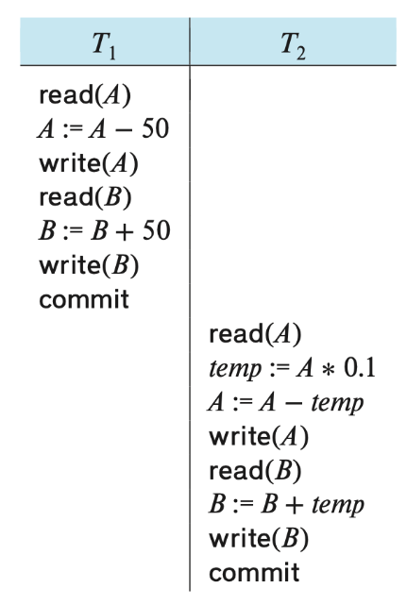
Schedules
Schedules represent the chronological order in which instructions are executed in the system.
A schedule for a set of transactions must consist of all instructions of those transactions and they must preserve the order in which the instructions appear in each individual transaction.

Slide 16
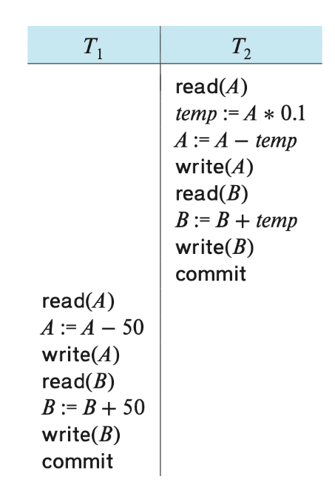

Slide 17
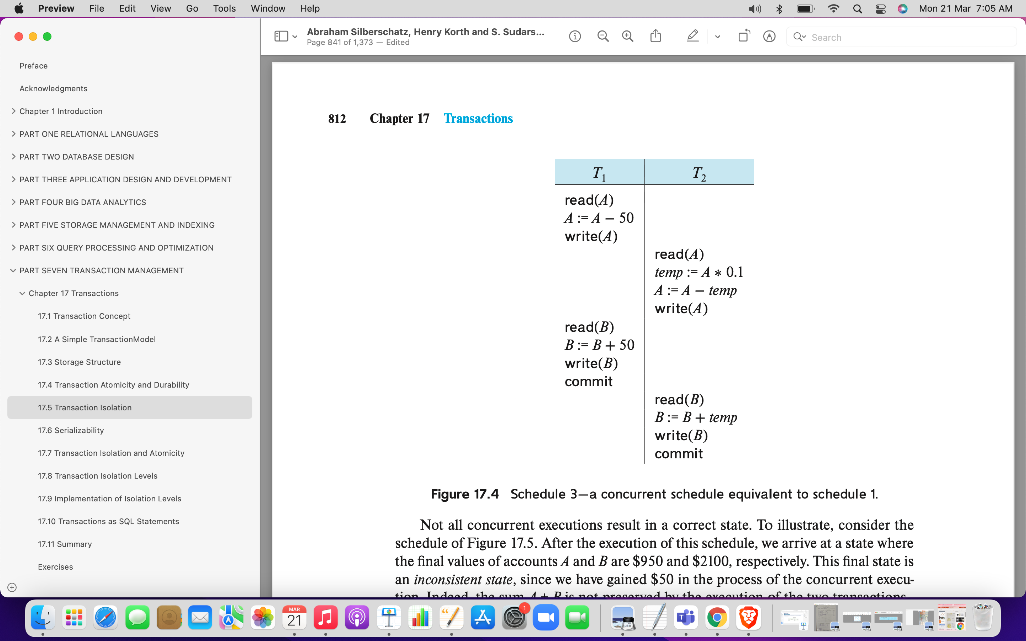
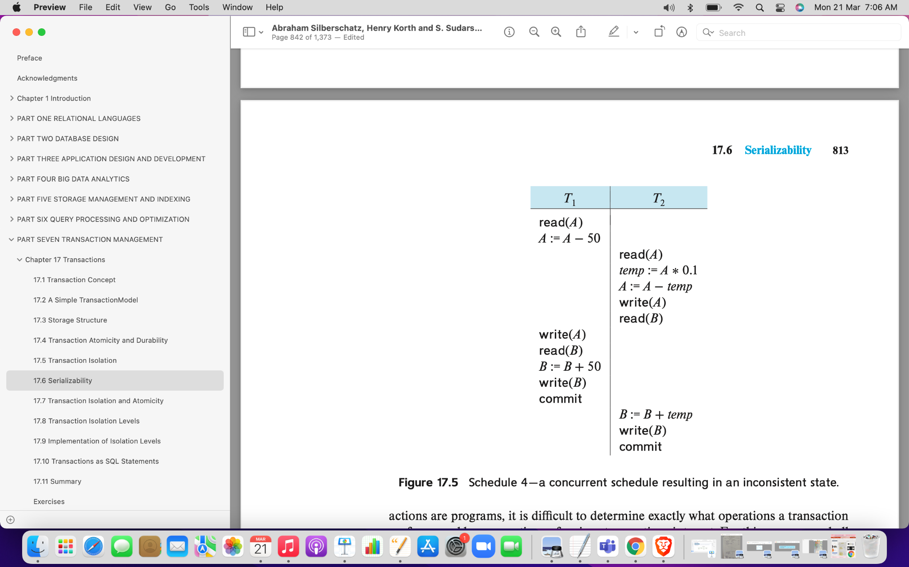

Slide 18
Conflict serializability
We continue to swap nonconflicting instructions:
• Swap the read(B) instruction of T1 with the read(A) instruction of T2.
• Swap the write(B) instruction of T1 with the write(A) instruction of T2.
• Swap the write(B) instruction of T1 with the read(A) instruction of T2.

